Slide 1
Data Prep
Sushma rangisetti
Group b

Slide 2
Code:
import pandas as pd
df = pd.read_csv("C:\\Users\\kiran\\OneDrive\\Desktop\\Card Fraud Detection\\application_data.csv")
# null_values = df.isnull().sum()
null_columns = df.columns[df.isnull().any()]
null_dtypes = df[null_columns].dtypes
null_count = df[null_columns].isnull().sum()
# null_values.to_csv("C:\\Users\\kiran\\OneDrive\\Desktop\\Card Fraud Detection\\nulls.csv")
null_info = pd.DataFrame({
'Datatype':null_dtypes,
'nUllcount':null_count
})
# print(null_values)
# print(null_dtypes)
null_info.to_csv("C:\\Users\\kiran\\OneDrive\\Desktop\\Card Fraud Detection\\nulls.csv")
print(null_info)

Slide 3
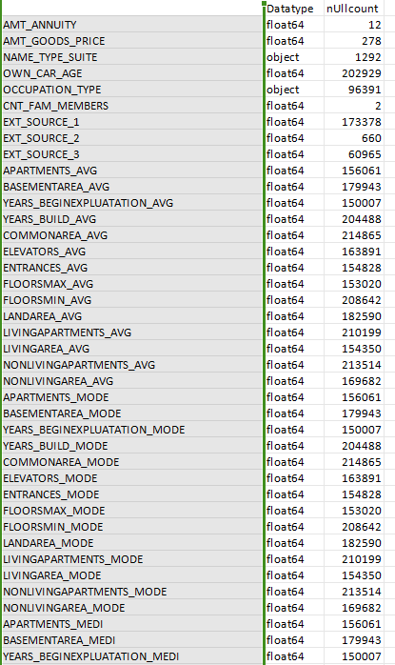
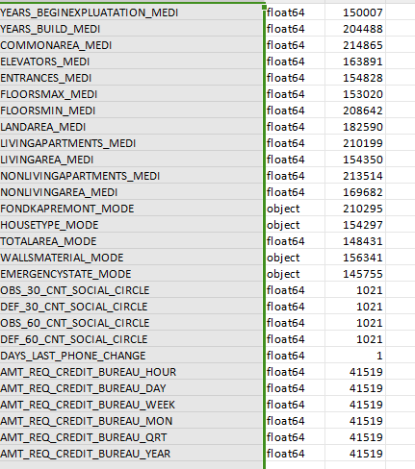
Output:
I have tried to find the null values in the dataset and also the count of the null values in each column.
I have even checked the datatype of the column that has null values and saved this data in a csv format file.
By observing the output,the categorical,numerical datatypes has null values.
These values can be filled by calculating mean,median,mode of the columns.

